Slide 1
Cognitive Science for AI
Reasoning

Slide 2
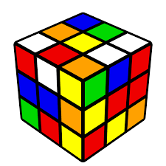
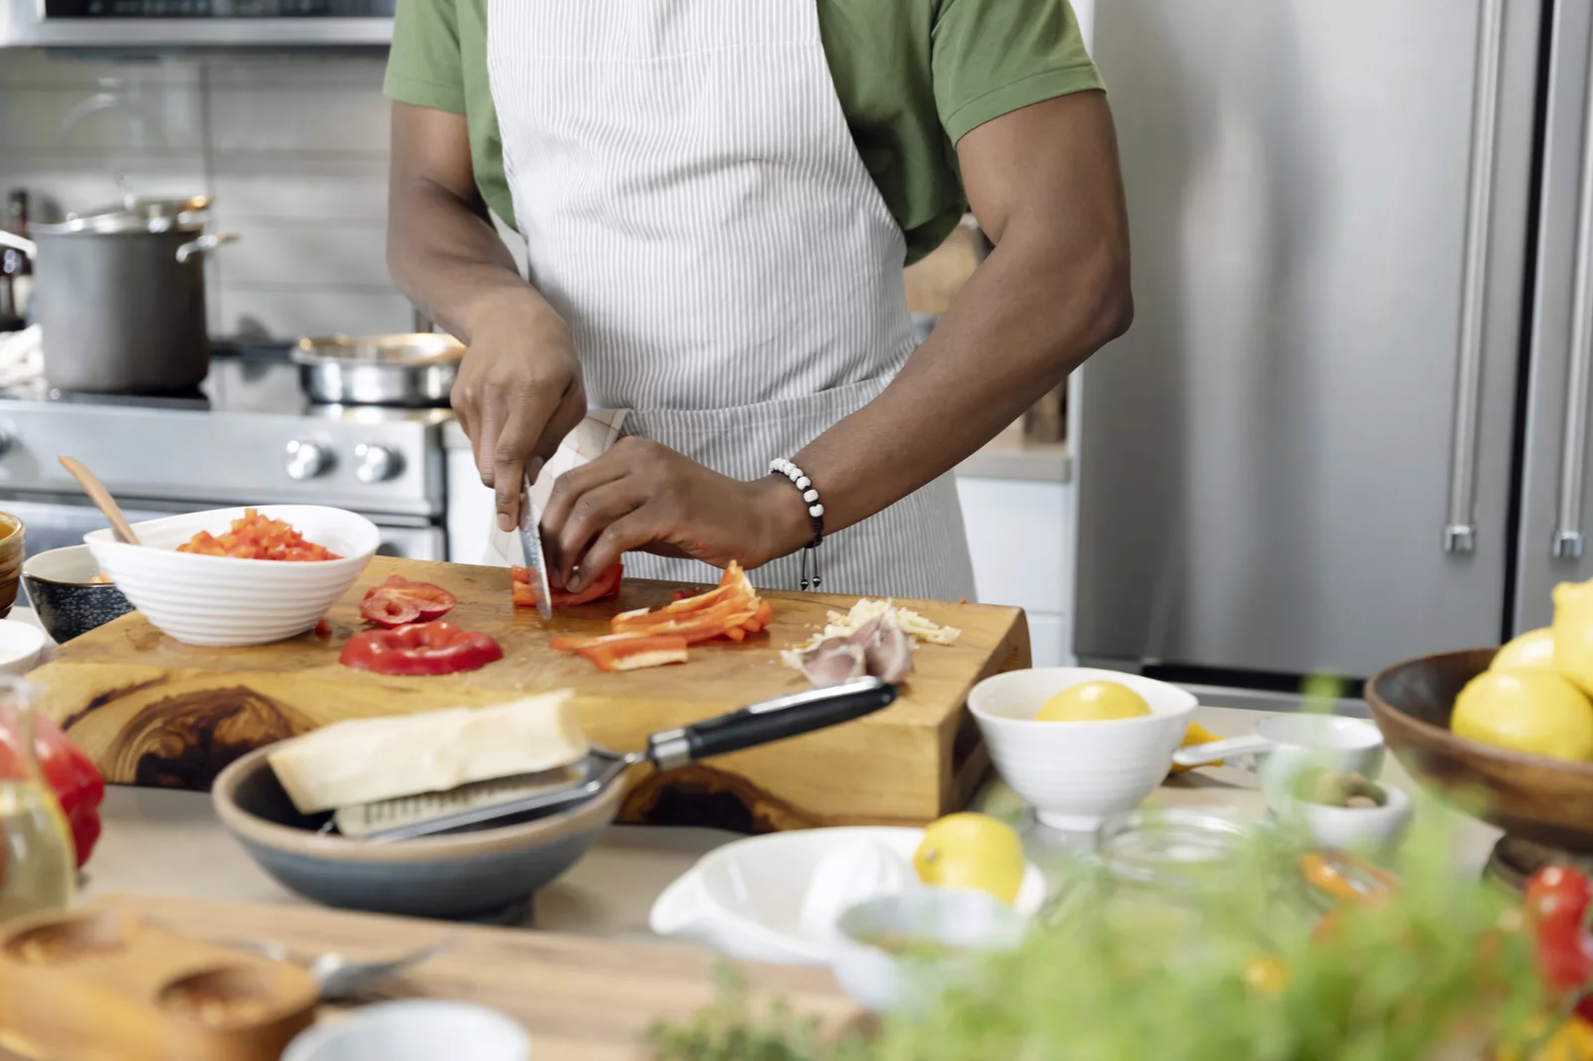

Reasoning and Problem Solving
https://www.npr.org/2023/01/27/1152155481/meal-prep-made-easy
https://www.officeforstudents.org.uk/news-blog-and-events/blog/freedom-to-question-challenge-and-debate/
https://en.wikipedia.org/wiki/Optimal_solutions_for_the_Rubik%27s_Cube

Slide 3
Rational Thought
Logic - propositional and first-order calculus
Probabilistic thinking - updating with Bayes
System 1 vs System 2
Fast - intuition, unconscious, probabilistic
Slow - deliberative, ‘rational’, rule based

Slide 4
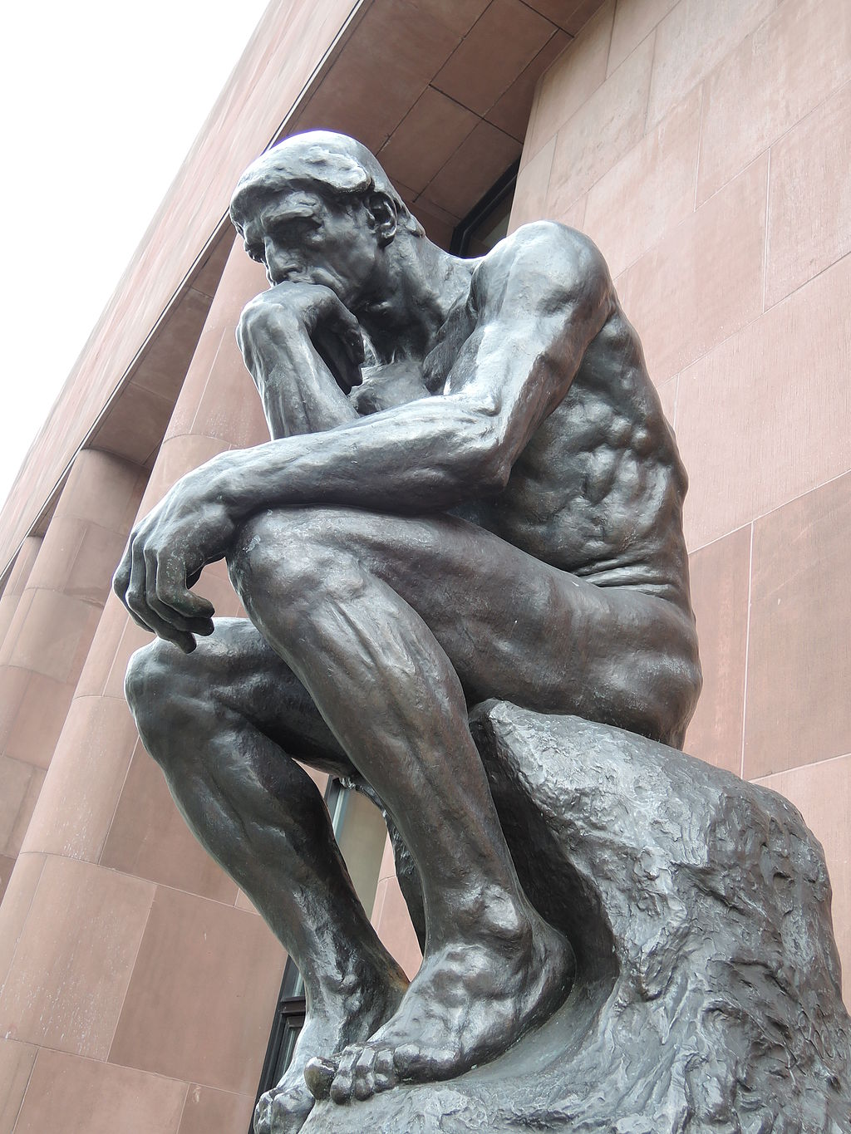
Thinking
Internal process - stream of consciousness
Step by step logical manipulations
Symbolic monologue
Nonsymbolic sequence of feelings/images
Counterfactuals, Hypotheticals
Awareness, Metacognition
Thinking about thoughts = Introspection
Theory of Mind
Mirror Test
Prisoner’s Dilemma
Rock Paper Scissors
https://en.wikipedia.org/wiki/Philosophy#/media/File:Le_Penseur_by_Rodin_(Kunsthalle_Bielefeld)_2014-04-10.JPG

Slide 5
Errors in Thinking - Cognitive Biases
Ways in which thought is off from ‘rational’ (logic and evidence)
‘Linda is a bank teller’ vs ‘Linda is a bank teller and a feminist’
Overgeneralization - similar items alike in other features
Priming, Anchoring - pattern on first items seen
Recency - pattern on most recent data
Confirmation Bias - accepting data that confirms hypothesis, ignoring contradicting data, cherry picking
Motivated reasoning - justifying desired ends through selective reasoning
Emotional reasoning - appeal to authority/force/numbers/association
Apophenia
finding a pattern where none exists
assuming agency where none exists

Slide 6
Kinds of Intelligence
Gardner
Logical-mathematical - abstract, symbolic - mathematician or programmer
Linguistic - words, languages, debate - lawyer or translator ‘wordcel’
Spatial - 3d representation - artist or architect, ‘shape rotator’
Bodily-kinesthetic - control of body - sports or crafts
Interpersonal - intentions and emotions - psychiatrist or coach
Naturalist - classifying natural phenomena, trivia
Others - music, drawing, games
Criteria: savants
Chollet - for testing abilities of AI
Fluidity: static repository vs run-time synthesis
Operational area: narrow (specific/low abstraction) vs broad (general/high)
Info efficiency: many example vs few examples

Slide 7
Kinds of Intelligence
Piantadosi - intelligence special to humans
Social reasoning: theory of mind, social learning, imitation
Relational Reasoning: relations between relations
Causal reasoning: higher order causal relations, complex tool use
Symbolic thought and language: symbolic representations, recursion
Measuring Intelligence
g - general measure of intelligence
IQ tests: “standardized test taking ability” - Math and Verbal
Clinical tests: MoCA - Montreal Cognitive Assessment

Slide 8
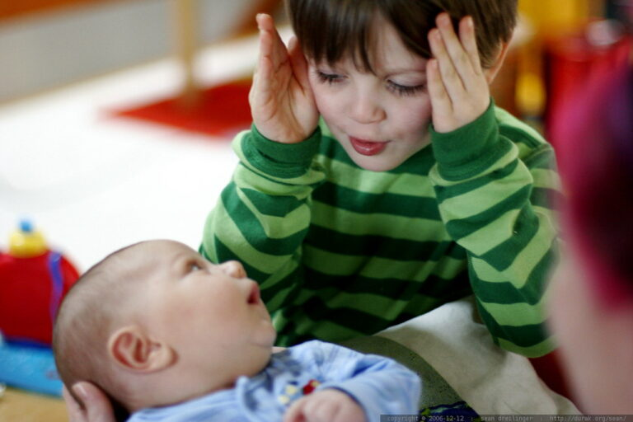
Child Development
From “blooming, buzzing confusion” to “Stephen Hawking”
Piaget’s stages
Sensorimotor 0-2
Object Concept
Pre-operational 2-7
Conservation, language
Concrete 7-11
Inductive logic
empathy
Formal 11-
Formal logic, symbolic operations
Video (1m) Object Permanance
Video (2m) Conservation number, volume
Video (1:30m) Point of View
“peek-a-boo – _MG_6709” by sean dreilinger.

Slide 9
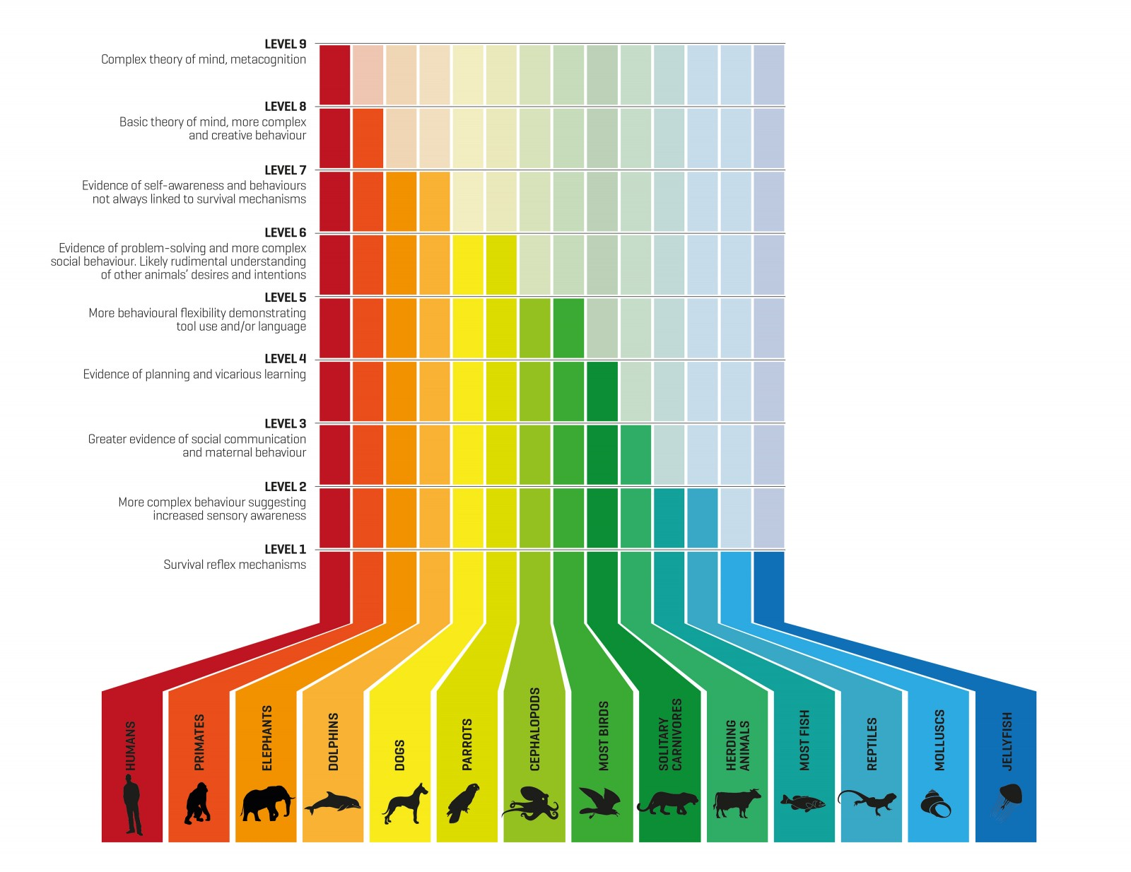
Levels of Animal Intelligence
Survival reflex mechanisms - Molluscs, Jellyfish
More complex behaviour suggesting increased sensory awareness - Reptiles, most Fish
Greater evidence of social communication and maternal behavior - herding Mammals
Evidence of planning and vicarious learning - solitary Carvnivores
More behavioural flexibility demonstrating tool use and/or language - most Birds, Cephalopods
Evidence of problem-solving and more complex social behavior. Likely rudimentary understanding of other animals' desires and intentions - Dogs, Parrots
Evidence of self-awareness and behaviours not always linked to survival mechanisms - Elephants, Dolphins
Basic theory of mind, more complex and creative behavior - Primates
Complex theory of mind, metacognition - Humans
https://www.nzgeo.com/stories/sentient-beings/

Slide 10
Culture
All human societies do all of the following. Other animals do not (mostly).
Tech - shelter, fire, tools, clothing
Food - cooperative hunting food planning (shepherding, farming), cooking, table manners, taboos
Society - kinship, status/hierarchy, property, marriage, ethics, law
Customs - magic, religion, rites of passage, play, music, stories, humor
What about numbers? writing?

Slide 11
Lessons from Cognition
There’s more to intelligence than book learning - not just a database of facts
There’s more to intelligence than reason - not a logic algorithm
There’s more to thought than language
‘Ecologically’ adaptive - successful in the environment
Multimodal - all of it works together at once, sight, hearing, body, context.
People fill in a lot of gaps (perceptually and logically)
Humans are the only animals with (with some simple exceptions):
Language with names/pronouns/recursion
Theory of mind - thinking is hard, thinking about thinking is even harder
Causal reasoning, logic, problem solving
A lot is currently unknown or inarticulated
We don’t know enough to simulate thinking
What about ‘common sense’ knowledge? What about ‘intuition’?
What is the correspondence between brain activity and a thought?

